Slide 2

The Road To Node

Slide 3
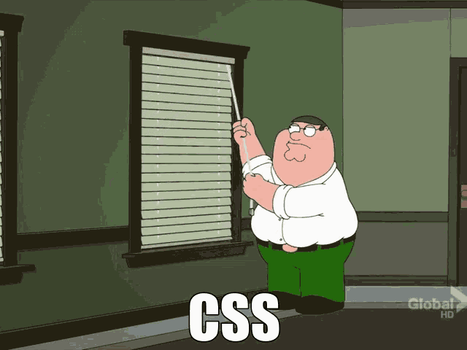
Your next 5 Weeks
1- Some basic front-end stuff

Slide 4
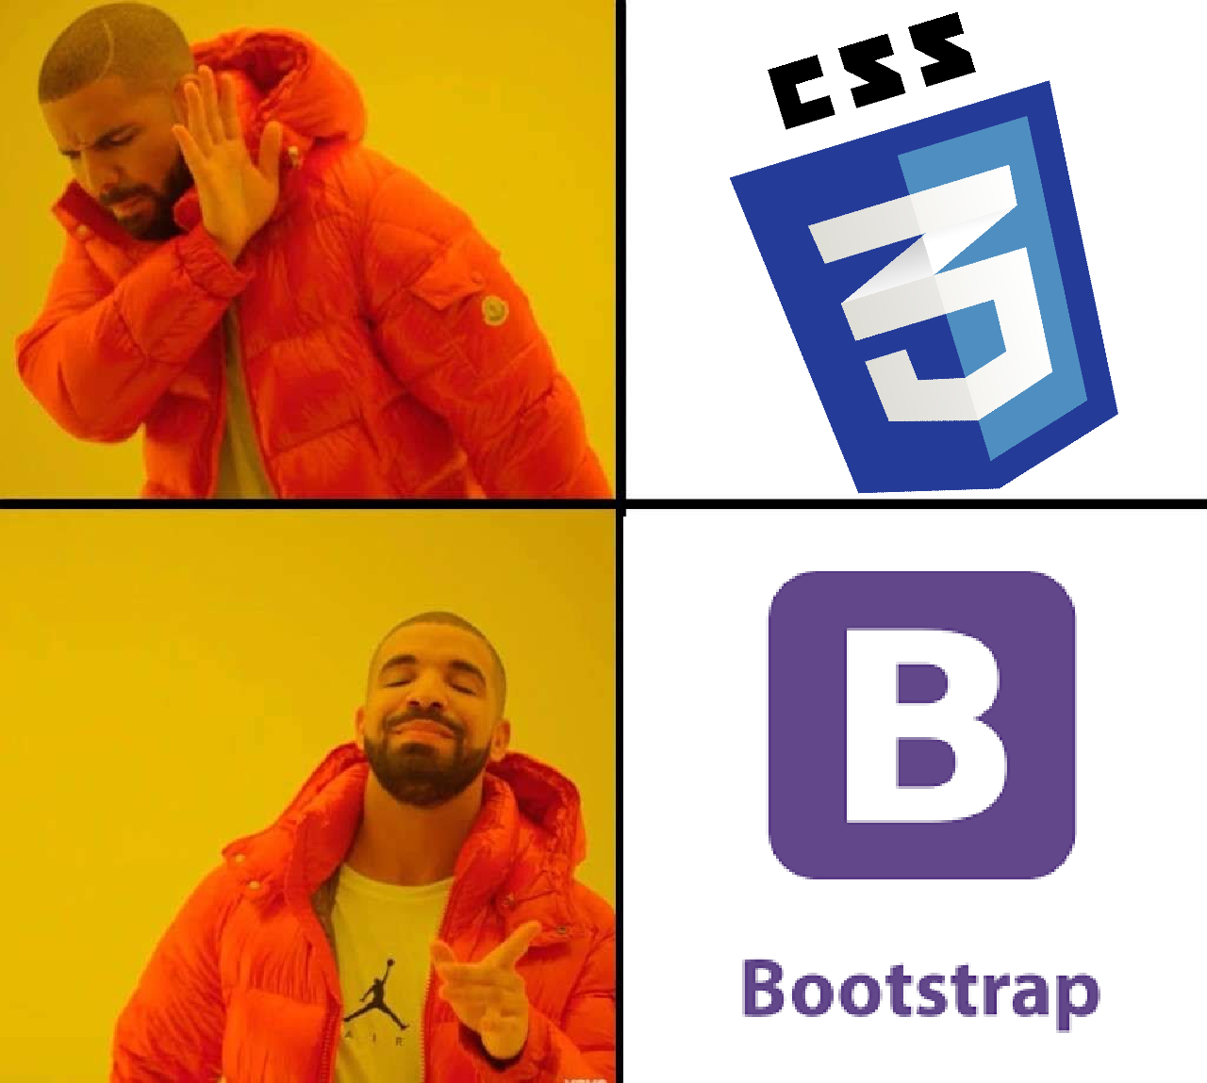

Slide 5

Your next 5 Weeks
2- Node.js Part 1
Syntax
Functions
NPM
Data types
And their methods
How to run ?
Packages
Json

Slide 6
Your next 5 Weeks
3- Node.js Part 2: Express
Web Server
Routing
Error Handling
Asynchronous actions
URLs
Get requests
Responses

Slide 7
Your next 5 Weeks
4- HTML Rendering Using Node.js
Html templating with Pug
Passing data to your html
Handling Post requests
Getting data from 3rd party API’s

Slide 8

Your next 5 Weeks
4.1- Hosting App On Azure

Slide 9

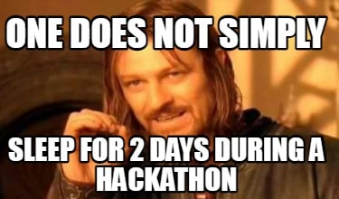

Slide 10
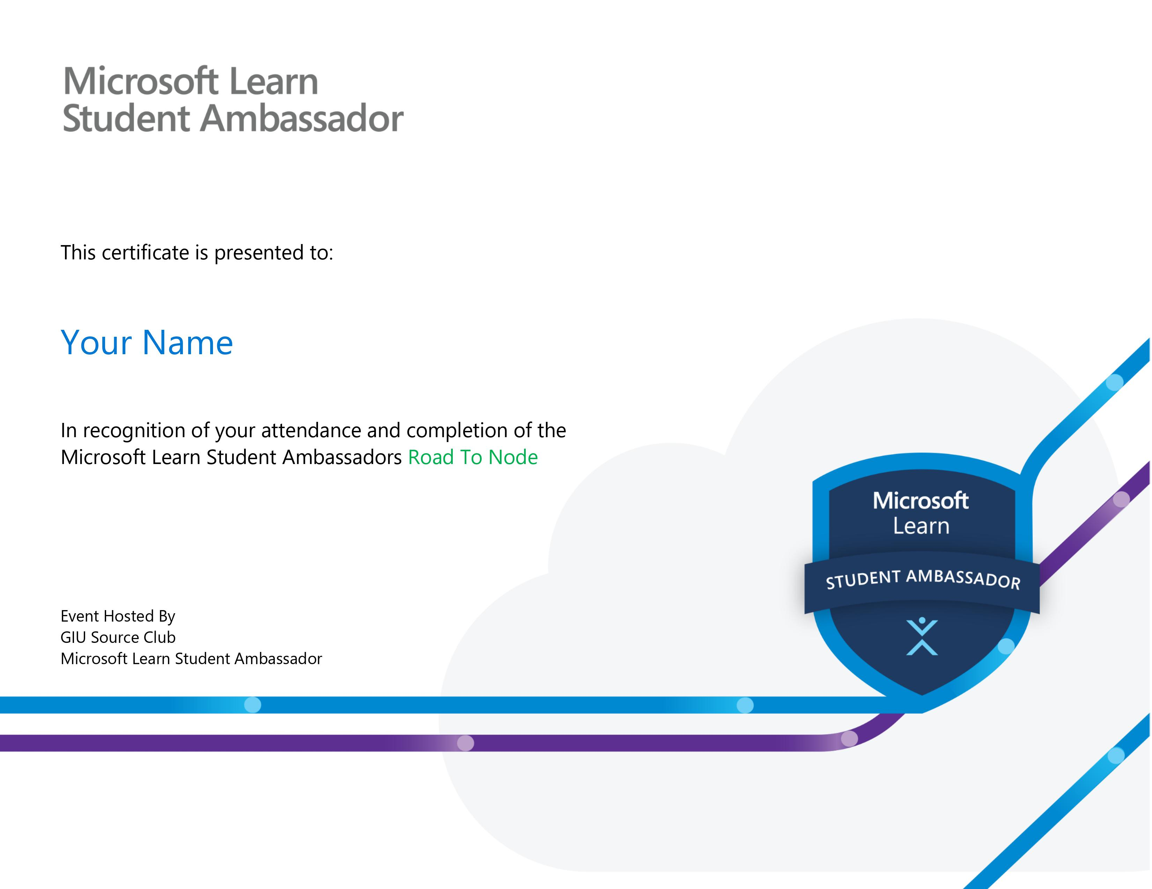

Slide 11


Join the discord server
https://discord.gg/gfQt3QWg

